Slide 1
Software-ontwerp
Presentatie: Iteratie 1
Karina Karapetyan
Laurens Cleemput
Tom Houben
Tri Tran

Slide 2
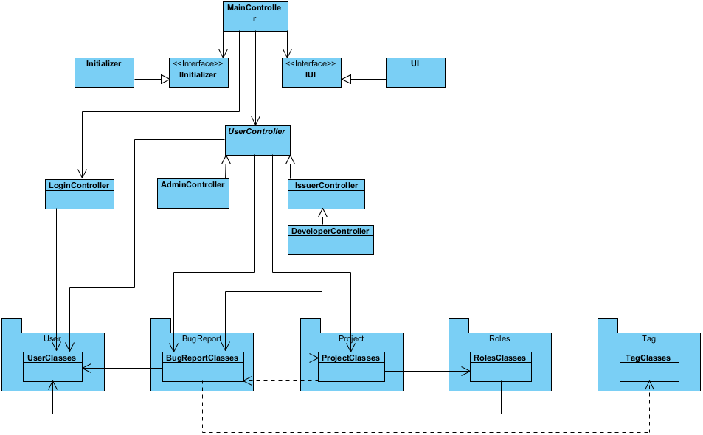
High Level Design

Slide 3
More detailed parts

Slide 4
Extensibility of system

Slide 5
Testing approach

Slide 6
(Einde Presentatie)

Slide 7
Project management (in uren)
Karina Karapetyan
Group work: 33 Individual Work: 22 Study: 7
Laurens Cleemput
Group work: 33 Individual Work: 16 Study: 8
Tom Houben
Group work: 33 Individual Work: 20 Study: 6
Tri Tran
Group work: 33 Individual Work: 40 Study: 15

